Slide 1
FAKE NEWS DETECTION USING MACHINE LEARNING.
TEAM MEMBERS:
Chandan Kumar Roy.
Prabal Dhar.
Sajjad Ali Dhuniya.
Amen Habtamu Asfaw.
Yogendra Naidu.

Slide 2
outline
Introduction.
Literature review.
Objectives.
Problem statement.

Slide 3
INTRODUCTION.
Fake news on social media and other forms of media is common and a major source of concern. There has been a rapid increase in the spread of fake news in the last decade.
Fake News contains false and unverifiable information. This cause to continue a lie about a specific information in a country or in world that cost to some services for a country, destroying lives in some countries, such as the Arab Spring.
Fake news can also affect a country's economy and business. At times resulting in market crashes.
62 percent of adults get news on social media in 2016, while in 2012; only 49 percent reported seeing news on social media

Slide 4
LITERATURE REVIEW.
S.No. | Author & Year. | Paper Title. | Proposed Method. | Limitation.
1. | Gerardo Ernesto Rolong Agudelo, Octavio José Salcedo Parra & Julio BarónVelandia -2018. | Raising a Model for Fake News Detection Using Machine Learning in Python. | The use of algorithms of Machine Learning like “CountVectorizer”, “TfidfVectorizer”, a Naive Bayes Model and natural language processing for the identification of false news in public data sets is proposed. | The classification of news is a complex task even using a standard procedure of classification of texts, since the news has a large number of characteristics that can be evaluated.
2. | Akshay Jain ,Amey Kasbe—2018. | social media fake news detection using Machine Learning. | We propose a method for "fake news" detection and ways to apply it on Facebook, one of the most popular online social media platforms.This method uses Naive Bayes classification model to predict whethera post on Facebook will be labeled as REAL or FAKE.The fake news detection problem can be addressed with machine learning methods. | Social media fake news detection cannot detect those news which are less share or like.To detect the social media news must be viral between social media users.It is not able to detect all the fake news but detect high number of social media news which are so much helpful for social media user.
3. | Z Khanam 2021. | Fake News Detection Using Machine Learning Approaches | Detecting fake news from different social media websites, but the results were not accurate for the untruthful sources. detect Twitter spam senders, with accuracy rated from 70% to 71.2%. Naïve Bayes, Neural Network and Support Vector Machine (SVM). 96.08% for detecting fake messages.

Slide 5
4. | Feyza Altunbey , OzbayBilalAlatas -2019. | Fake news detection within online social media using supervised artificial intelligence algorithms | A two-step method for identifying fake news in social media is proposed.• An experimental evaluation of the intelligent classification methods is performed.• Methods are tested on three real data sets in terms of different evaluation metrics.
5. | M. Granik and V. Mesyura -2017. | A SMART SYSTEM FOR FAKE NEWS DETECTION USING MACHINE LEARNING | Curbing fake news is crucial in the information age We already have some level of success using well known algorithms Other more efficient methods of classification and distribution of fake news identification are on the horizon

Slide 6
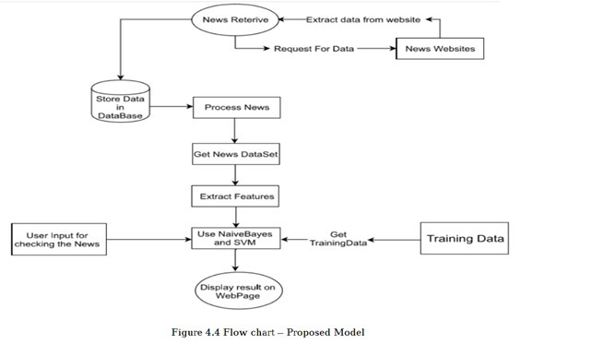
Proposed Method

Slide 7
Objectives.
To successfully stop the spreading of fake news, which has increased in volume and has led to more and more misinformation, leading to various forms of property harm and fatalities.
Our research looks into various textual properties that can be used to difference between real and fake content.
The main goal is to detect fake news, which is a classic text classification problem with a simple proposition. It is necessary to develop a model capable of different between "real" and "fake" news.

Slide 8
Problem statement.
As proposed above our main problem of identifying fake news is done through integrating multiple processes together. This might include web scraping for data collection, Database systems for data storing, Different machine algorithm implementation for classification and distribution of the acquired insight to the user.
We propose for the next problem of proper distribution of the gained insights building an interface that integrates seamlessly into users news sources. This could be browser extensions or other viable solutions.

Slide 9
Source.
Google.
Google scholar.
https://link.springer.com/chapter/10.1007/978-3-030-02131-3_52#Sec3
https://ieeexplore.ieee.org/abstract/document/8546944
https://iopscience.iop.org/article/10.1088/1757-899X/1099/1/012040
https://www.sciencedirect.com/science/article/abs/pii/S0378437119317546
https://iopscience.iop.org/article/10.1088/1757-899X/1099/1/012040/meta

Slide 10
Thank you...

